Slide 1
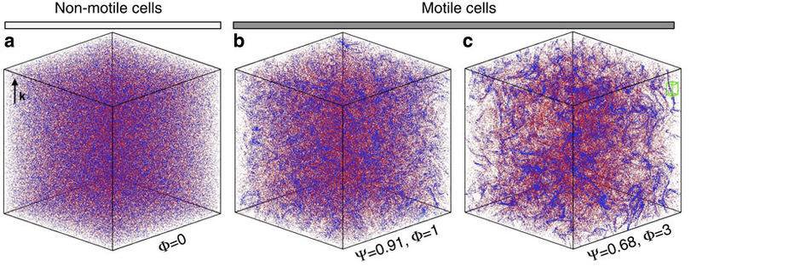
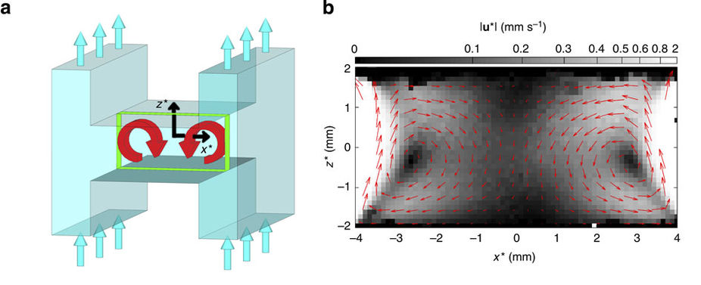
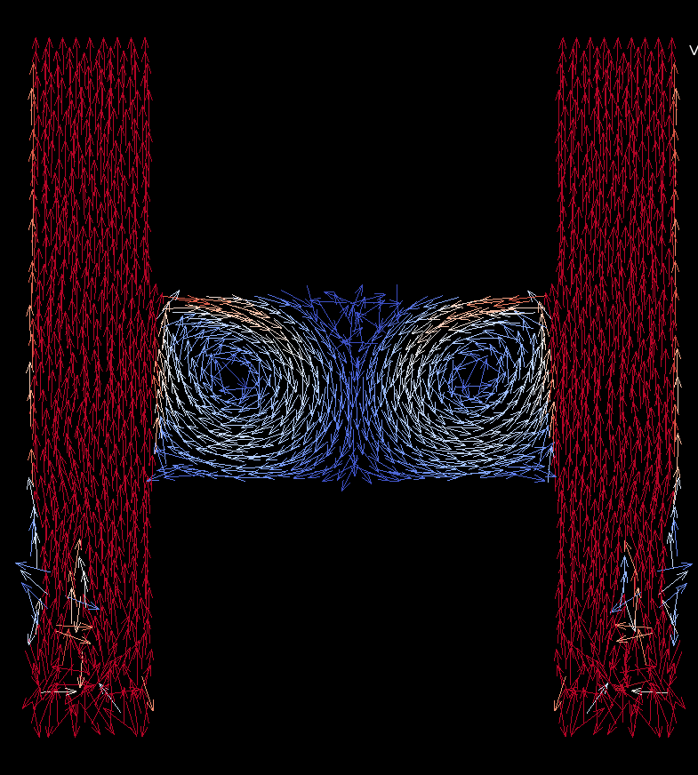
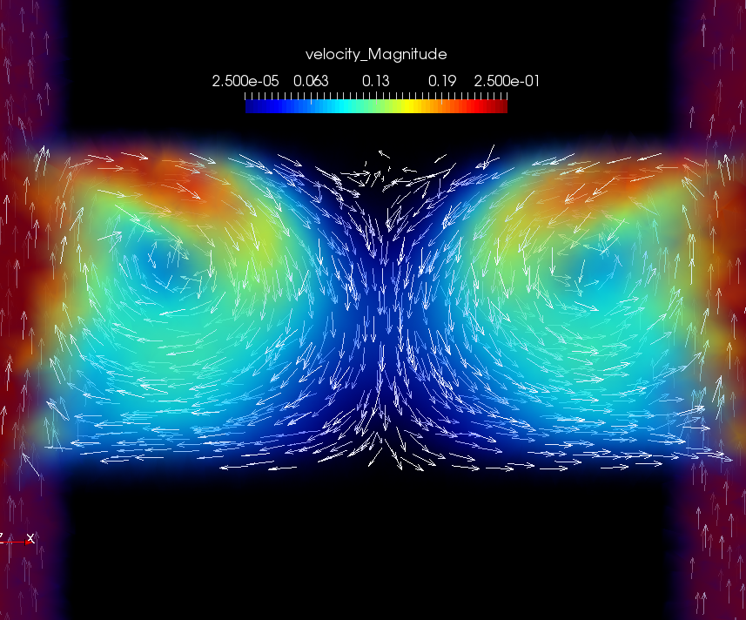
Individual-Based Models for Ocean Microbes - Preliminary project: turbulence-driven patchiness in gravitactic phytoplankton
(Durham et al. 2013)
Progress to date:

